Slide 1

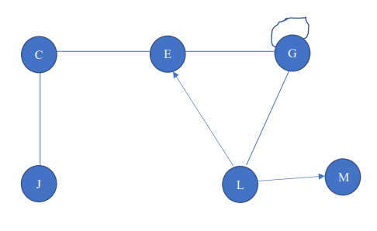
Lista de adyacencia
C
E
J
E
C
G
G
G
E
L
J
C
PILA | VERTICES PROCESADOS
J
C | J
E | C
G | E
L | G
M | L
PILA VACIA | M
L
E
G
M
M
CLAVE GL02 2021

Slide 2

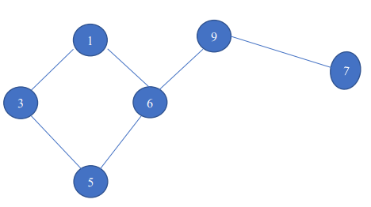
MATRIZ DE ADYACENCIA
 | 1 | 3 | 5 | 6 | 7 | 9
1 | 0 | 1 | 0 | 1 | 0 | 0
3 | 1 | 0 | 1 | 0 | 0 | 0
5 | 0 | 1 | 0 | 1 | 0 | 0
6 | 1 | 0 | 1 | 0 | 0 | 1
7 | 0 | 0 | 0 | 0 | 0 | 1
9 | 0 | 0 | 0 | 1 | 1 | 0
RECORRIDO EN ANCHURA
COLA | VERTICES PROCESADOS
5
3-6 | 5
6-1 | 3
1-9 | 6
9 | 1
7 | 9
COLA VACIA | 7
CLAVE GL03 2021

Slide 3
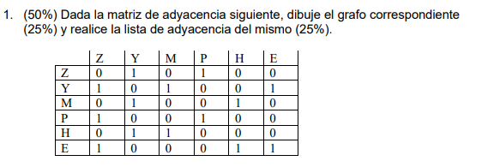
Y
Z
CLAVE GL01 2021
M
P
=
E
H

